Slide 1
Theories of Ego Network Layers

Slide 2
Levels of Analysis in social networks
Individual
1
Dyads
2
Triads
3
Cliques, Communities
4
Whole Network
5
The first part of the course follows this organization!

Slide 3
Levels of Analysis in social networks
Ego Networks
Individual
1
Dyads
2
Triads
3
Cliques, Communities
4
Whole Network
5
The first part of the course follows this organization!

Slide 4
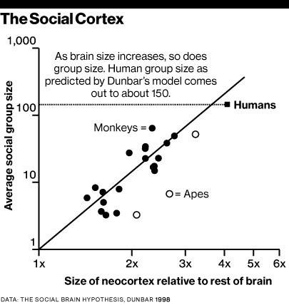
Ego networks: Social brain hypothesis
Why is your (human) head so big?
  In comparison to our closest primate ancestors
Because humans are very social animals!
  Finding:
    Neocortex size scales with average group size for all primates
  Explanation:
    The brain is for keeping track of other people (among other things)
Dunbar, R. I. M. (2003). Evolution of the social brain. Science, 302, 1160 –1161.

Slide 5
Ego Networks: Dunbar Circles
Ego-networks are organized by “layers”
  “Closer” more intimate layers
  “Farther” less intimate ones
  Closer layers are smaller
  Farther layers are larger
Closeness

Slide 6
Ego Networks: Dunbar Circles
Ego-networks are organized by “layers”
  “Closer” more intimate layers
  “Farther” less intimate ones
  Closer layers are smaller
  Farther layers are larger
Different relationships entails different “maintenance costs”
  Cognitive/Emotional
  Time/Energy
    Costs determine the number of persons in each layer
Closeness

Slide 7
Ego Networks: Dunbar Circles
Support clique (~ 4 - 5)
  Your most intimate kin and best friends you can rely on them for crises and emergencies
Support Clique (4-5)
Ego
Closeness

Slide 8
Ego Networks: Dunbar Circles
Support clique (~ 4 - 5)
  Your most intimate kin and best friends you can rely on them for crises and emergencies
Sympathy group (~12 - 15)
  Kin and good friends that can provide some services and that you interact with often
Sympathy Group (12-15)
Support Clique (4-5)
Ego
Closeness

Slide 9
Ego Networks: Dunbar Circles
Support clique (~ 4 - 5)
  Your most intimate kin and best friends you can rely on them for crises and emergencies
Sympathy group (~12 - 15)
  Kin and good friends that can provide some services and that you interact with often
Affinity group (~ 45 - 50)
  More casual but still close friends, extended family
Affinity Group (45-50
Ego
Sympathy Group (12-15)
Support Clique (4-5)
Ego
Closeness

Slide 10
Ego Networks: Dunbar Circles
Support clique (~ 4 - 5)
  Your most intimate kin and best friends you can rely on them for crises and emergencies
Sympathy group (~12 - 15)
  Kin and good friends that can provide some services and that you interact with often
Affinity group (~ 45 - 50)
  More casual but still close friends, extended family
Affinity Group (45-50
Ego
Sympathy Group (12-15)
Support Clique (4-5)
Ego
Closeness

Slide 11
Ego Networks: Dunbar Circles
Support clique (~ 4 - 5)
  Your most intimate kin and best friends you can rely on them for crises and emergencies
Sympathy group (~12 - 15)
  Kin and good friends that can provide some services and that you interact with often
Affinity group (~ 45 - 50)
  More casual but still close friends, extended family
Active Network (~120 - 150)
  Total number people that you recognize by face/name and interact with at least once a year
Active Network(120-150)
Affinity Group (45-50
Ego
Sympathy Group (12-15)
Support Clique (4-5)
Ego
Closeness

Slide 12
Tie Strength

Slide 13
Properties of Social Ties
In Social Network Analysis social ties can have different properties
  A property of social ties is a characteristic that can be different for ties of the same type
For instance:
  Some ties are new, and some ties are old
    New friends versus old friends
  Some ties are durable (hard to break) others are nondurable (easy to break)
    Durable relations (mother) versus nondurable relations (coworker)
  Some ties are frequently activated others are infrequently activated
    Friends you see all the time versus friends you see once in a while
  Some ties are intimate and other ties are not intimate
    Friends you confide in versus Friends that you do not confide in

Slide 14
Tie properties: Strength
In Social Network Analysis social ties can have different properties
  A property of social ties is a characteristic that differentiates ties of the same type
Out of all the properties tie strength is the most important one
  Some ties are strong and some ties are weak
“The strength of a tie is a...combination of the amount of time, the emotional intensity, the intimacy (mutual confiding) and the reciprocal services which characterize the tie” (Granovetter 1973: 1361).
A
B
A
B
Strong Tie
Weak Tie
Granovetter, M. S. (1973). The strength of weak ties. American journal of sociology, 78(6), 1360-1380.

Slide 15





The Four Pillars of Tie Strength
Time
Intensity
Intimacy
Reciprocity
Characterized by the amount of time, duration, and frequency of contact.
The emotional intensity and closeness that characterizes the tie.
Defined by mutual confiding and personal depth in the relationship.
The reciprocal services and mutual aid provided by each person.

Slide 16
Tie properties: Strength
According to Granovetter, tie strength is a combination of different tie properties
Ties are strong if:
  Have lasted for a long time
  Are frequently activated
  Are emotionally intimate
  Feature exchanges of favors
Tie Strength
Duration
Time Spent Together
Emotional Intensity
Intimacy/Confiding
Interaction Freq.

Slide 17
Tie properties: Strength
According to Granovetter, tie strength is a combination of different tie properties
Ties are weak if:
  Have recently started
  Are infrequently activated
  Lack emotional intimacy
  Don’t Feature exchanges of favors
Tie Strength
Duration
Time Spent Together
Emotional Intensity
Intimacy/Confiding
Interaction Freq.

Slide 18

When do people have a social tie?
We can divide the four different types of social ties into two clusters:
  Similarities and relations are types of states (static situations)
  Interactions and flows are types of events (processes in time)
Borgatti, S. P., Mehra, A., Brass, D. J., & Labianca, G. (2009). Network analysis in the social sciences. Science, 323(5916), 892-895.

Slide 19
Dyad properties: Strength
Tie Strength
Duration
Time Spent Together
Emotional Intensity
Intimacy/Confiding
Interaction Freq.
Similarities
Sentiment
Exchanges
Communication
“The strength of a tie is a...combination of the amount of time, the emotional intensity, the intimacy (mutual confiding) and the reciprocal services which characterize the tie” (Granovetter 1973: 1361).

Slide 20
Tie properties: Strength
Just having one property (e.g., frequent activation) is not sufficient for a tie to count as strong
  You can see a coworker you hate every weekday
  You can tell an acquaintance an intimate secret
Some ties of a particular type (e.g., kin ties, same race ties) are expected to be strong
  But they don’t have to be!
  You can be estranged from your parents or siblings
Tie Strength
Duration
Time Spent Together
Emotional Intensity
Intimacy/Confiding
Interaction Freq.

Slide 21
Tie properties: Strength
Just having one property (e.g., frequent activation) is not sufficient for a tie to count as strong
  You can see a coworker you hate every weekday
  You can tell an acquaintance an intimate secret
It is better to say that there is a positive correlation between a tie being of some type (e.g., similarity, kin, positive sentiment) and tie strength
    Similar-race ties are likely to be strong
    Kin-ties are likely to be strong
    Coworker ties are likely to be weak
    Positive sentiment ties are likely to be strong
    Same neighborhood ties are likely to be weak
    Acquaintanceship ties are likely to be weak

Slide 22
Tie properties: Strength
Just having one property (e.g., frequent activation) is not sufficient for a tie to count as strong
  You can see a coworker you hate every weekday
  You can tell an acquaintance an intimate secret
Strong ties sound great!
  Does that mean that weak ties are useless?
  No! We will see one way in which they are pretty useful
Tie Strength
Duration
Time Spent Together
Emotional Intensity
Intimacy/Confiding
Interaction Freq.

Slide 23
How Do Ties Become Strong?

Slide 24
Friedkin’s Stage Model of Tie Strengthening
Friedkin (1990) proposes that interpersonal tie strength is not a simple linear combination of variables, but a qualitative progression through distinct developmental stages.

Slide 25


Friedkin’s Stage Model of Tie Strengthening
According to Friedkin ties usually beging by regular communication and frequent interaction.
Frequent Discussion
Claims of regular interaction regarding school or professional matters. The baseline of attachment.

Slide 26


Friedkin’s Stage Model of Tie Strengthening
Help seeking, support, and confiding, presupose some interactional basis so that usually comes next.
  You wouldn’t ask someone you don’t interact with often for help
Frequent Discussion
Help Seeking
Claims of regular interaction regarding school or professional matters. The baseline of attachment.
Turning to the other for information or advice. Indicates trust and perceived credibility.

Slide 27


Friedkin’s Stage Model of Tie Strengthening
Finally deeper more emotionally intimate friendship presupose both frequent interaction and having a history of support and confiding
Frequent Discussion
Help Seeking
Close Friendship
Claims of regular interaction regarding school or professional matters. The baseline of attachment.
Turning to the other for information or advice. Indicates trust and perceived credibility.
Subjective claim of intimate bond. Represents the highest level of tie strength.

Slide 28
Social Capital and Tie Strength

Slide 29
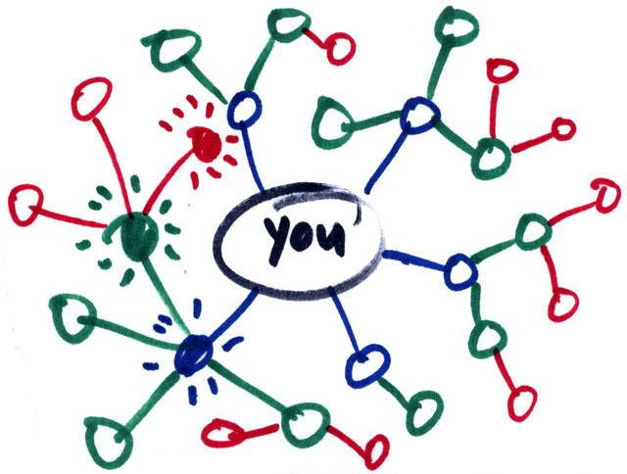
What is social capital?
Social capital:
  Benefits accrued as the result of your connections
    People who are better connected do better
What can you get from your connections?
  Some benefits from strongly connected networks:
    Social and emotional support
      Trusting somebody with an intimate secret
    Companionship
      Having somebody to hang out with
    Material support
      knowing where to go in a time of need

Slide 30
What is social capital?
Social capital:
  Benefits accrued as the result of your connections
    People who are better connected do better
What can you get from your connections?
  Some benefits from weakly connected networks:
    Novel information
      Finding out about things that your close contacts might not know
    New or cutting-edge ideas
      Combining different ideas into a new idea
    New people
      Being introduced to people who can help

Slide 31
The Strength of Weak Ties

Slide 32
Granovetter’s strength of weak ties theory
Concept:
  Granovetter-transitivity (g-transitivity)
    Rule 1: if two people are strongly connected they are likely to have a lot of other friends in common
A
B
Strong Tie

Slide 33
Granovetter’s strength of weak ties theory
Concept:
  Granovetter-transitivity (g-transitivity)
    Rule 1: if two people are strongly connected they are likely to have a lot of other friends in common
    Rule 2: if A and B have a strong tie and B and C have a strong tie there should be at least a weak tie between A and C
Good probability of
existing tie!
C
Strong Tie
A
B
Strong Tie

Slide 34
Granovetter’s strength of weak ties theory
Concept:
  Granovetter-transitivity (g-transitivity)
    Rule 1: if two people are strongly connected they are likely to have a lot of other friends in common
    Rule 2: if A and B have a strong tie and B and C have a strong tie there should be at least a weak tie between A and C
  Reasons for g-transitivity:
    Demographic similarity
    Shared memberships
    Propinquity
Good probability of
existing tie!
C
Strong Tie
A
B
Strong Tie

Slide 35
Granovetter’s strength of weak ties theory
Concept:
  Granovetter’s weak tie principle:
    Weak ties allow for a violation of g-transitivity
    You don’t have to be connected to the people who are connected to the people whom you only have a weak tie connection to
Good probability of
no tie!
C
Strong Tie
A
B
Weak Tie

Slide 36
Strength of weak ties theory
Application of the g-transitivity principle to ego-network layers:
  G-transitivity more likely to apply to strong ties in your support clique and sympathy group
Implication:
  Weak ties in you active network less likely to be connected to one another
G-transitive ties
G-transitivity violations

Slide 37
Strength of weak ties theory
Application of the g-transitivity principle to ego-network layers:
  Weak ties can function as bridges to parts of social structure to which you wouldn’t have access
Implication:
  Absent weak ties:
    You will not have access to distant parts of the social system
    Information will tend to be local
    Will put you at a disadvantage when novel information is valuable

Slide 38
Strength of weak ties theory
People who may know something your close friends don’t know
Application of the g-transitivity principle to ego-network layers:
  Weak ties can function as bridges to parts of social structure to which you wouldn’t have access
Implication:
  Absent weak ties:
    You will not have access to distant parts of the social system
    Information will tend to be local
    Will put you at a disadvantage when novel information is valuable
Broker
Bridging tie

Slide 39
Strength of weak ties theory
People who may know something your close friends don’t know
Acquaintances less like to be connected to one another that close friends
In graph theoretic terms:
  The subgraph of ego’s neighbors who are strongly tied to ego has high density
  The subgraph of ego’s neighbors who are weakly tied to ego has low density
Broker
Bridging tie

Slide 40
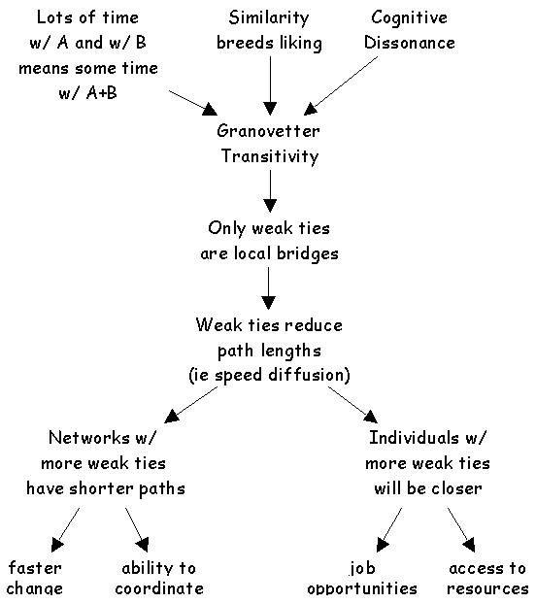
Application: Getting a job
If social mobility (e.g. finding new job opportunities) depends on (new) information access:
  Then having weak ties will be correlated with mobility and other forms of success
  Contacts with whom you are weakly connected will be more likely to know something you don’t know
  Weak ties help you insofar as they connect you to others with access to both information and resources

Slide 41
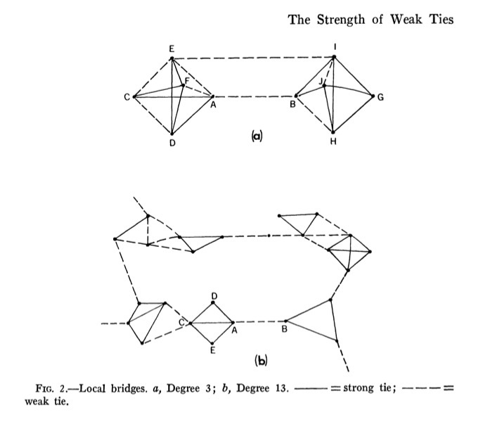
Strength of weak ties theory: Whole Network
At the level of the social system absence of weak ties implies:
  Fragmentation into disconnected communities characterized by strong tie clusters
  Diffusion of new ideas in such a system would be difficult
    Innovations remain trapped in local clusters
  Collective action and global coordination would be difficult
    Social divisions will be salient

Slide 42
Strength of weak ties theory: Whole Network
Classical sociological theory presumed that weak ties bred alienation and disconnection from others
The weak tie argument suggests that weak ties actually integrate people into wider social structures
  Strong ties connect you similar others
  Weak ties connect you to different others
    Interacting with different others forces you to be flexible

Slide 43
Testing SWT

Slide 44
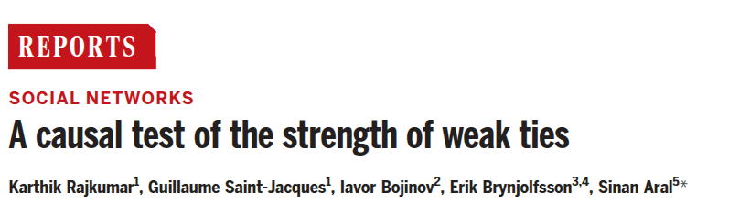
Testing SWT
Despite 50 years of influence, previous studies testing SWT were largely correlational
  In the typical design we can retrospectively ask individuals how they found a job and then compared jobs found via weak ties with jobs found via strong ties (or other methods)
  This approach cannot account for selection bias (e.g., high-ability individuals might naturally have more weak ties).
  Some recent correlational studies even created a "paradox" by suggesting strong ties were actually more valuable for job mobility.

Slide 45
Testing SWT
An experimental approach in which the job search method (e.g., weak versus strong ties) is exogeneously manipulated would be the “dream experiment” to test STW
  This is what Rakjumar et al. did in a 2022 paper published in the journal Science
  To achieve true exogenous variation, users were randomized into one of seven “People You May Know” (PYMK) algorithm variants for follower recommendations divided into two broad types

Slide 46




Testing SWT
Weak-Tie Promoters
Strong-Tie Promoters
Variants that algorithmically up-weighted connection recommendations with fewer mutual friends. This randomly increased the probability of users forming structurally weak ties.
Variants that algorithmically up-weighted recommendations with many mutual friends. This reinforced the formation of dense, closed network clusters.

Slide 47
Testing SWT
A 5-Year Longitudinal Analysis
  The scale of this experiment provides robust causal inference at a massive global level.
The study successfully tracked:
  20 Million Experimental Subjects (People on LinkedIn)
  2 Billion New Network Ties
  600,000 Job Transitions

Slide 48





Testing SWT
Structural Strength
Interaction Strength
Job Transmission
Measured by "Common Connections". More shared friends between two individuals indicate a structurally stronger tie in the graph.
Measured by "Message Intensity". Evaluates how frequently two users actually communicate directly on the platform.
The key outcome metric: A user adds a connection and subsequently joins that connection’s exact employer.

Slide 49





Testing SWT
Operationalizing "Job Transmission"
  Measuring the dependent variable required tracking a precise chronological sequence over the 5-year observation window:
  This chronological sequencing ensures the network tie explicitly preceded the job change, solidifying the causal direction.
1. Connection
2. Baseline
3. Transmission
User A and User B form a new tie on LinkedIn via PYMK.
User A works at Company X.
User B works at Company Y.
User A leaves Company X and is hired at Company Y.

Slide 50
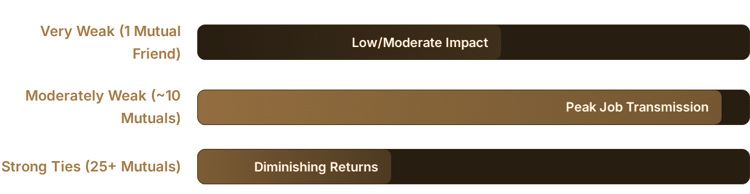
Testing SWT
Causal evidence confirms weak ties are effective, but the relationship is non-linear based on shared neighbors.
  Moderate overlap provides enough familiarity to motivate help, while maintaining enough distance to provide novel informational value.

Slide 51




Testing SWT
However, the causal test using the communication frequency dimension of tie strength yields unequivocal support for SWT
  The study evaluated "strength" using two distinct metrics, yielding nuanced but crucial differences in the results:
Structural Strength (Mutual Friends)
Interaction Strength (Messaging)
Displays the Inverted U-Shape shown previously. The most helpful ties are moderately weak (~10 mutuals). Total strangers (1 mutual) lacked the trust or motivation to assist in the hiring process.
Displays a Linear Negative Relationship. The ties with the absolute lowest message frequency (the most arms-length relationships) actually delivered the highest number of overall job transmissions.

Slide 52
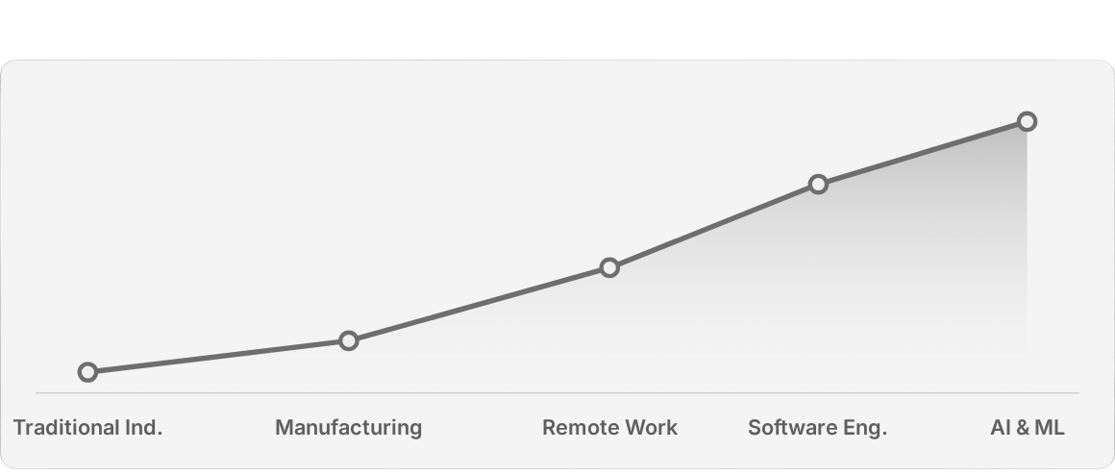
Testing SWT
Causal evidence confirms weak ties are effective, but the relationship is non-linear based on mutual connections.
  Weak ties significantly outperform strong ties specifically within High-Tech and Digitally-Intense sectors.

